Slide 1

Impact of Customer Preferences on Airbnb Revenue
Notes:
Objective

Slide 2
AGENDA
Objective
Background
Key Findings
Recommendations
Appendix:
Data sources
Some other insights
Data methodology
Data model assumptions
Notes:
Objective

Slide 3
OBJECTIVE
Improve our strategies to revive the business in the post-COVID period.
Understand customer preferences and user experience trends from Airbnb NYC business.
Provide early recommendations for market traction and improving customer experience by adjusting existing properties to make it more customer oriented.
Notes:
Objective

Slide 4
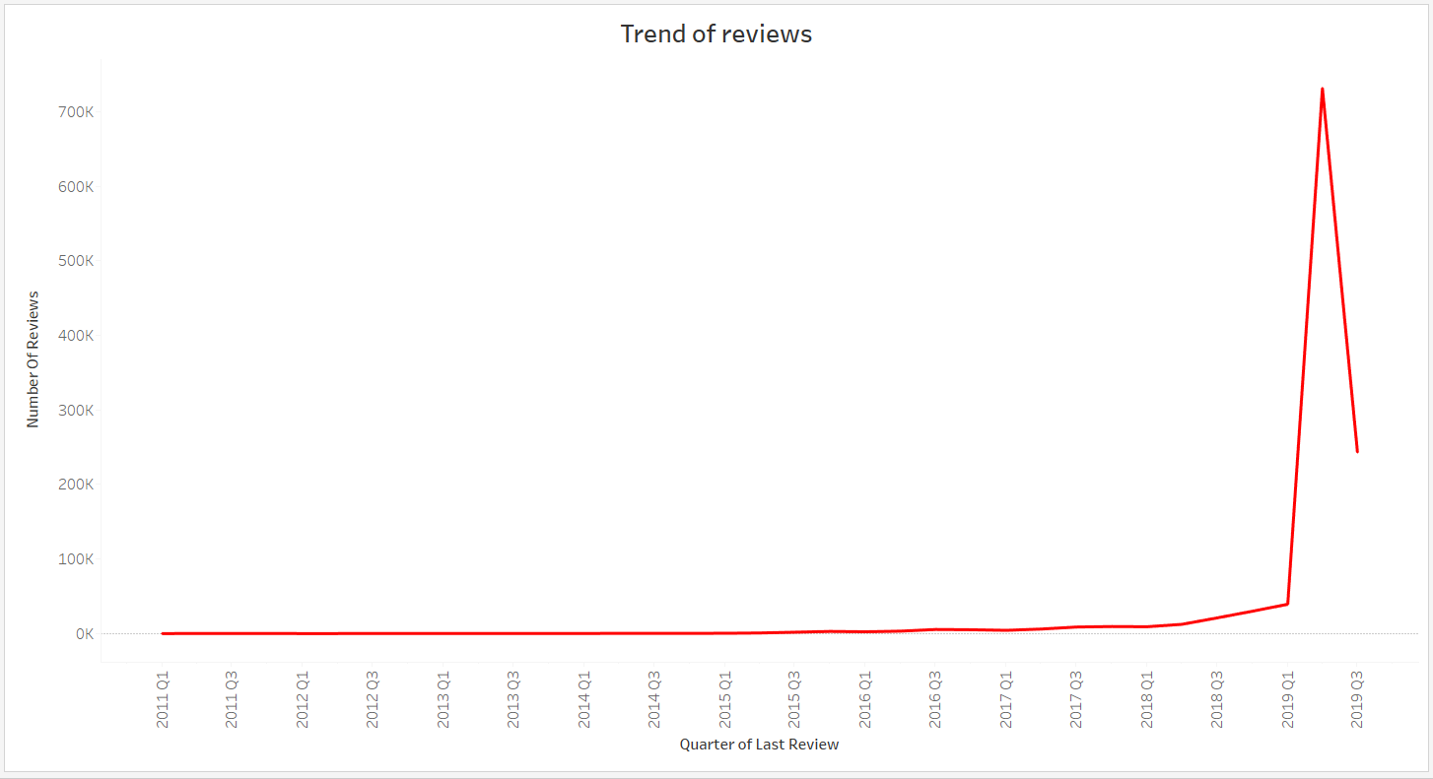
BACKGROUND
The COVID-19 pandemic affected Airbnb business due to travel restrictions.
The revenue took the largest hit in NYC in the Q2 and Q3 of 2019.
Now that the travel restrictions are lifted, the business should be operated to recover the loss.
Notes:
Objective

Slide 5
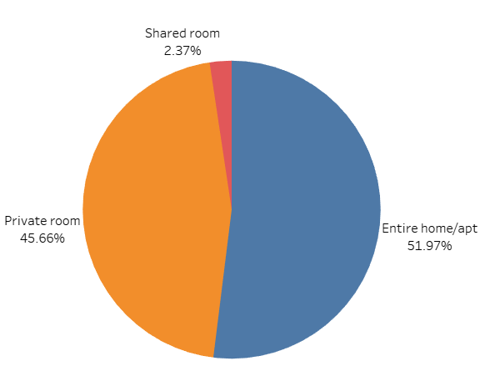
Customer preferences for ‘Entire home/apt’ and ‘Private room’ remain high post-COVID
‘Entire home/apt’ and ‘Private room’ account for a major portion of the listed properties(97.63%) in NYC in pre-COVID time and this may remain prevail in the post COVID time as well.
Only 2.37% of the room type belong to ‘Shared room’ category.
Customers would prefer to isolate themselves; hence ‘Shared rooms’ can be converted to ‘Private room’ to increase footfall and revenue.

Slide 6
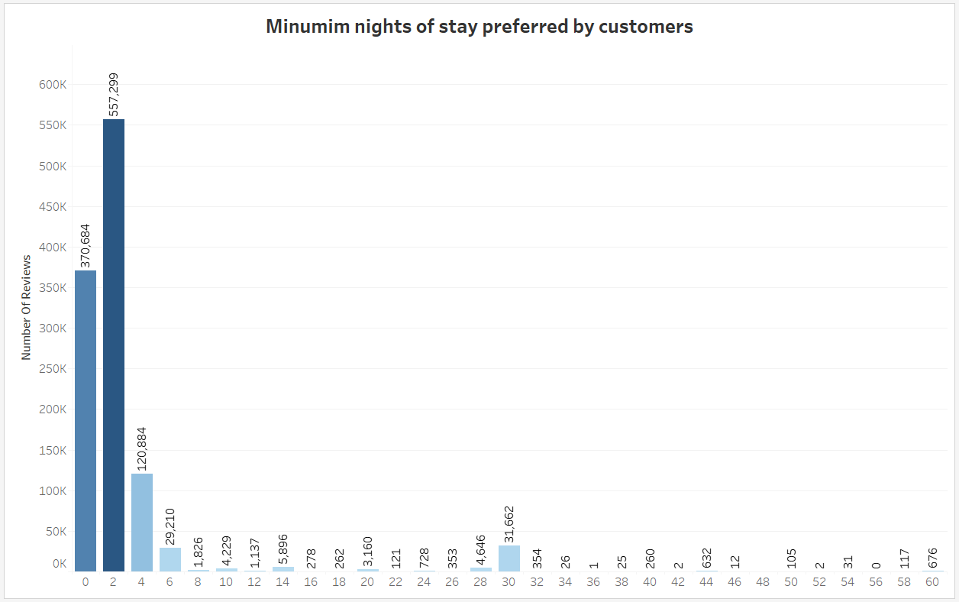
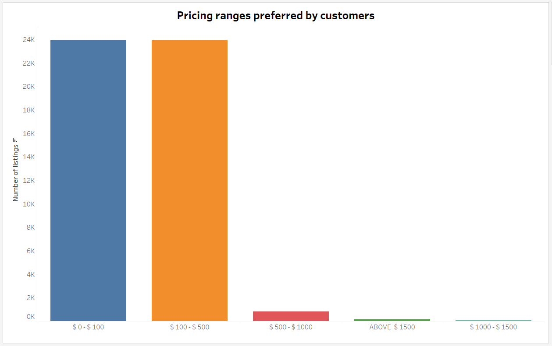
Target hosts offering the least minimum nights of stay
Properties offering the least minimum number of nights to stay have the highest number of reviews.
As the minimum number of nights to stay increases, the minimum expense to stay at the property increases and bookings to these properties will decline due to exorbitant prices.
Premium properties are not visited much, hence their acquisition should not be prioritized in the current circumstances. Acquire properties which are budget friendly.

Slide 7
Properties with least minimum nights to stay offer maximum bookings
Customers prefer 1-10 days of minimum nights per stay based on the number of reviews. There is spike for 30, 60 and 90 days during pre-COVID time.
Properties with a higher number of minimum nights of stay and higher price have low reviews during pre-COVID time. Due to ongoing pandemic, customers may prefer to book properties for 30, 60 or 90 days to avoid frequent travelling. *
It has been observed that majority of bookings are done for apartments, where the minimum number of days is the least.
Assumption: With COVID-19, it is reasonable to assume that people will book properties for longer periods of time(15 or 30 or 60 or 90 days of stay)

Slide 8
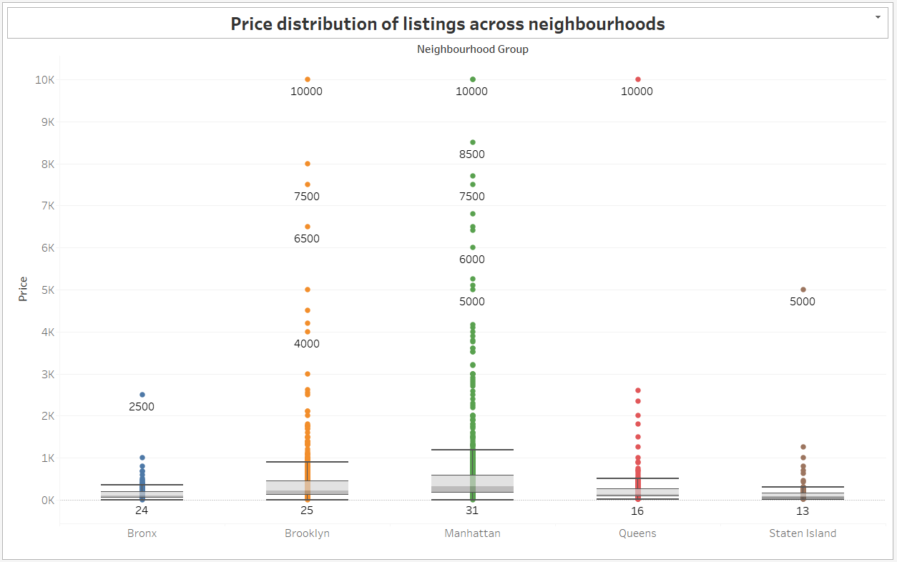
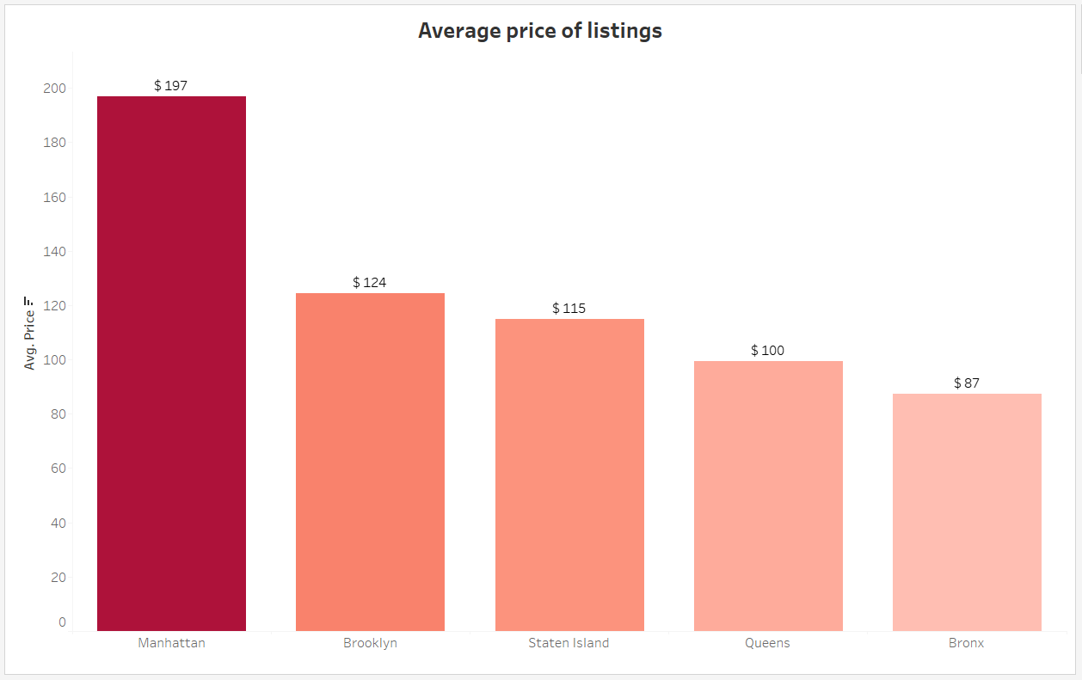
Acquiring Premium Properties in Bronx & Non-Premium Properties in Manhattan
Premium properties in Bronx and Queens must be targeted as they cost an upwards of $ 2500.
Non-premium properties in Manhattan and Brooklyn must be targeted. Premium properties are exorbitant and may not attract a lot of bookings. Cheaper listings are usually preferred in these localities.

Slide 9
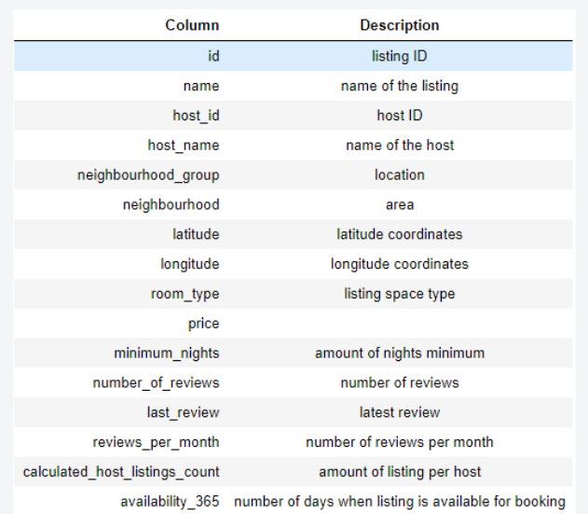
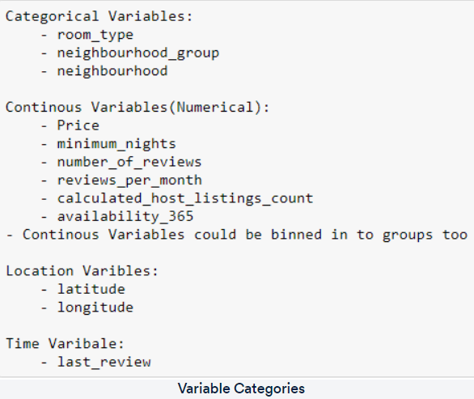
APPENDIX – DATA SOURCES

Slide 10
APPENDIX – OTHER INSIGHTS
Manhattan and Brooklyn bookings prefer Entire Home/Apartment and Private rooms.
Bronx and Queens bookings prefer Private rooms over Entire Home/Apartment.
Multiple hosts have more than 10 listings at different neighborhoods.
Manhattan and Brooklyn are most popular neighborhoods with regards to total number of listings. The two neighborhoods account for 82.7% of the listings in NYC.
Average price of listing per neighborhood is $197 for Manhattan which is much higher than the other neighborhoods.
Williamsburg, Bedford-Stuyvesant, and Harlem are popular localities in NYC.
Notes:
Objective

Slide 11
APPENDIX - DATA METHODOLOGY
Performed analysis on Airbnb dataset using Python and Tableau.
Missing values in few columns were treated and simple statistical analysis of data was performed.
Visuals were derived to understand customer preferences based on
Room type
Area preference
Price
Number of reviews
Minimum nights to stay
Notes:
Objective

Slide 12
APPENDIX - DATA ASSUMPTIONS
We assumed the data prior to the COVID – 19 period was achieving the desired revenue.
We assumed unpopular properties are the ones that have not been reviewed even once.
We assumed the company does not want to expand yet to new territories in NYC.
The company’s strategies are decided considering the travel will increased in the post COVID period.
Notes:
Objective

